Slide 1
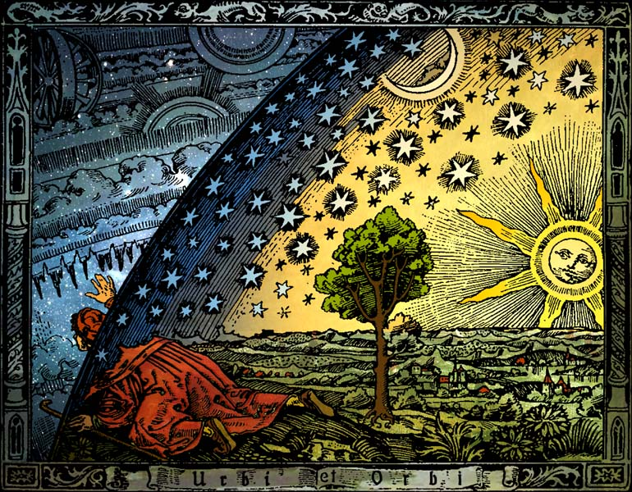
Motivating Mechanics Using Astronomy and Space Science
J. C. Amato and E. J. Galvez
Department of Physics and Astronomy
Colgate University, Hamilton, NY
Camille Flammarion 1888

Slide 2
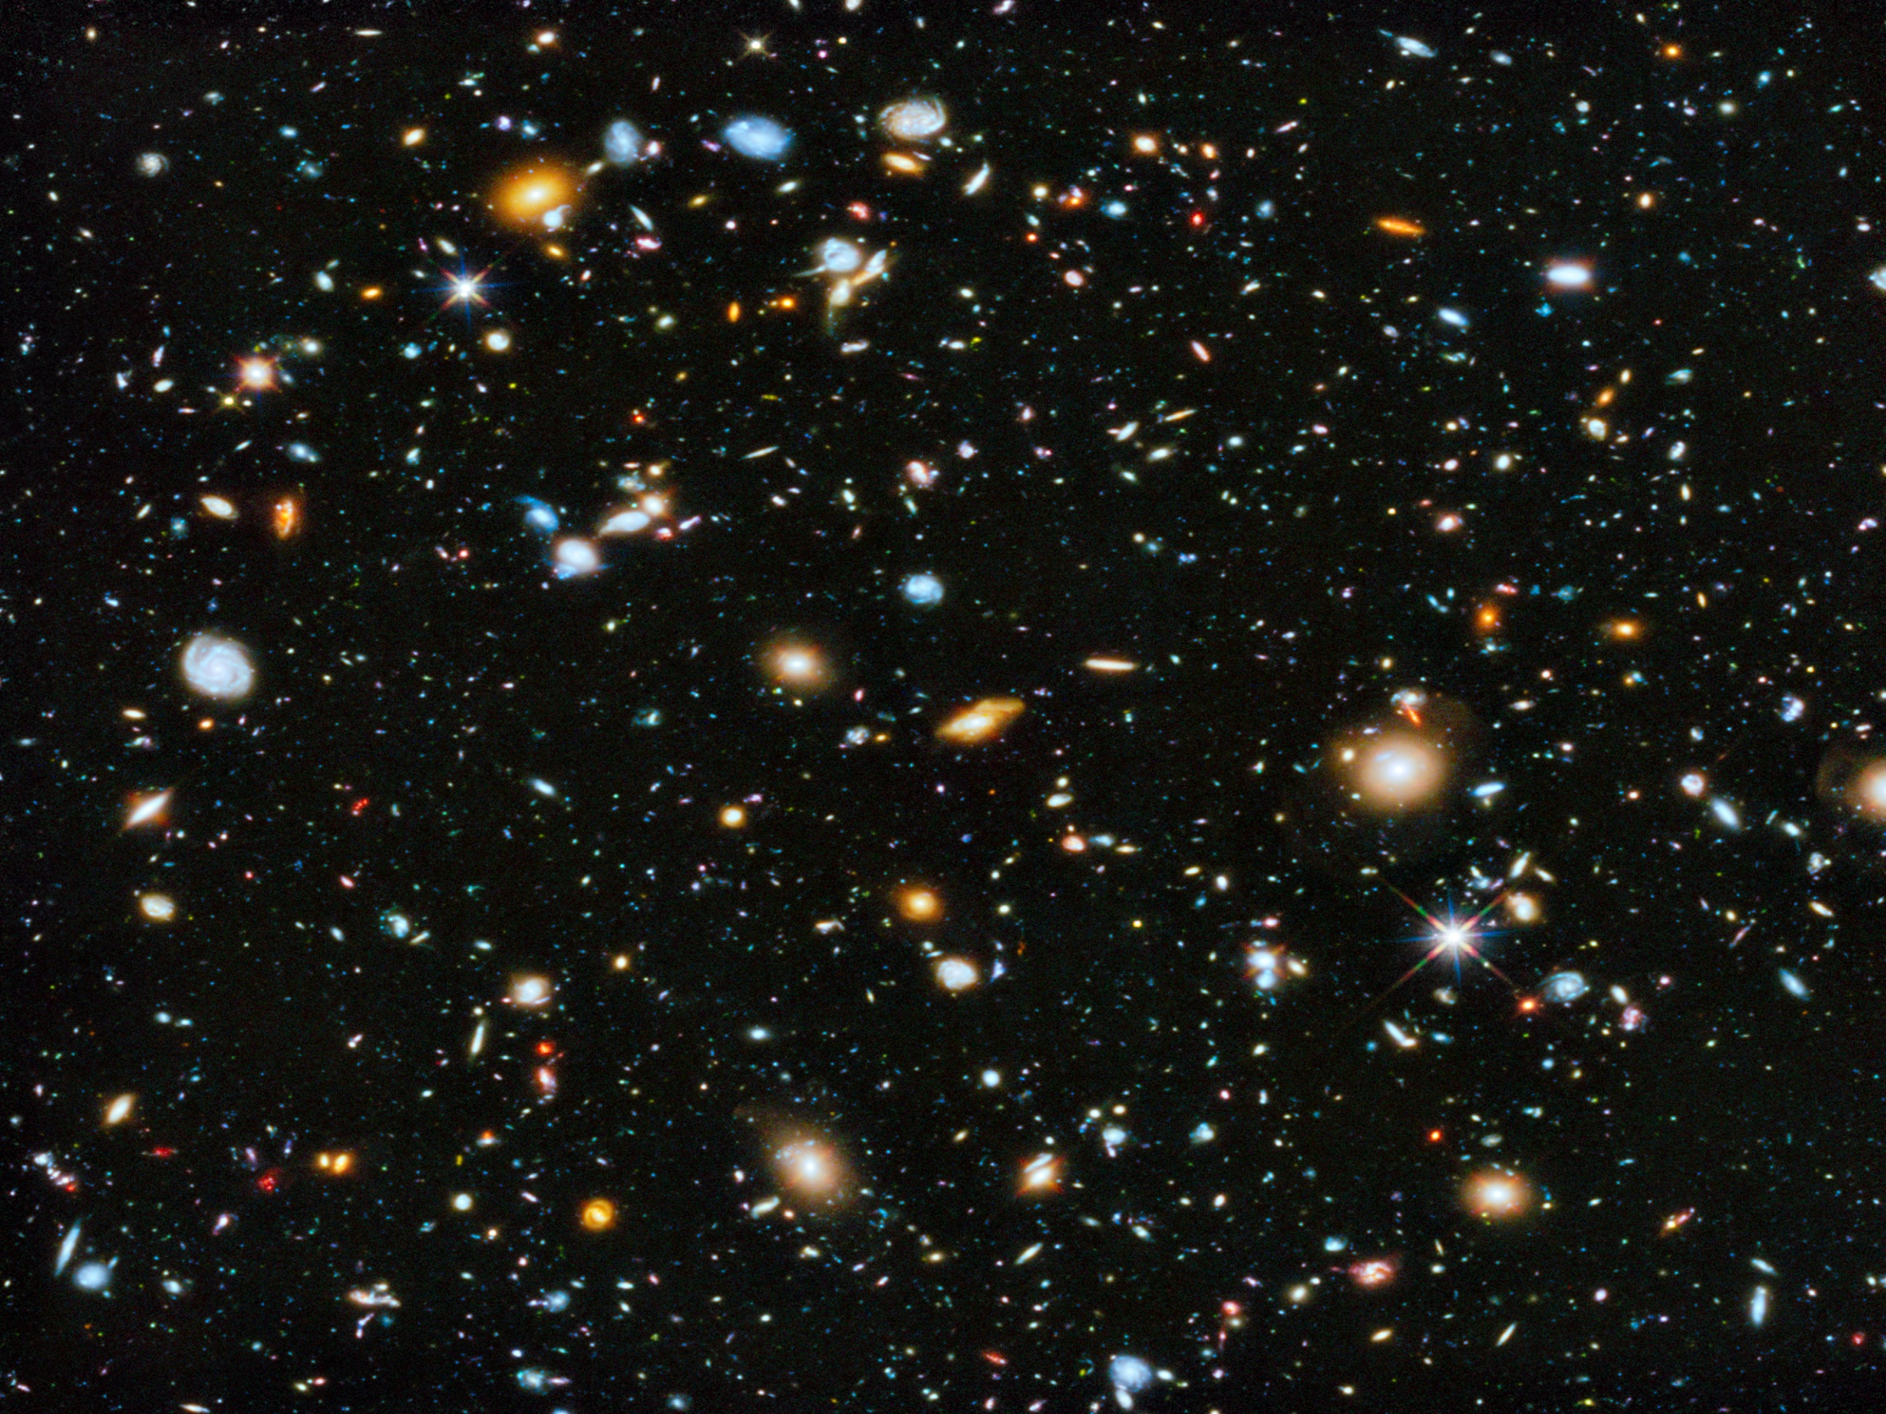
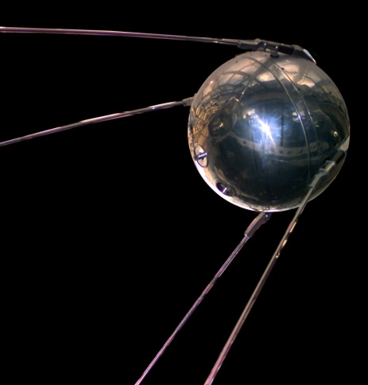
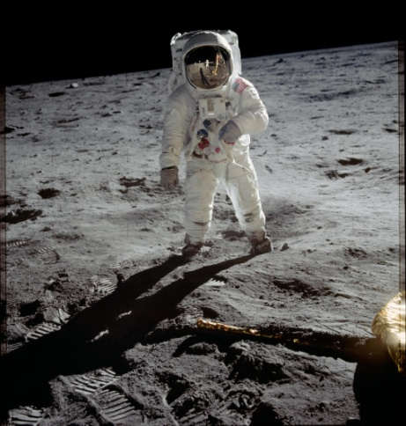

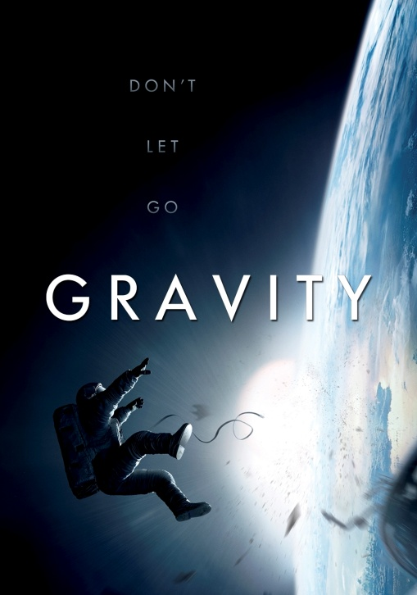
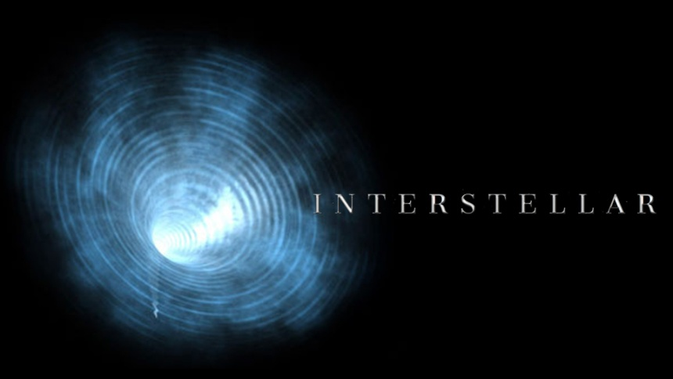
Astronomy: an enduring motivator
1960’s
1970’s
2010’s

Slide 3
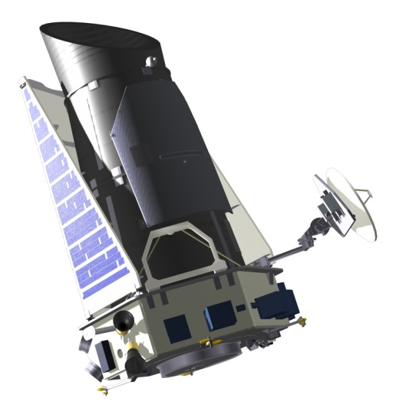
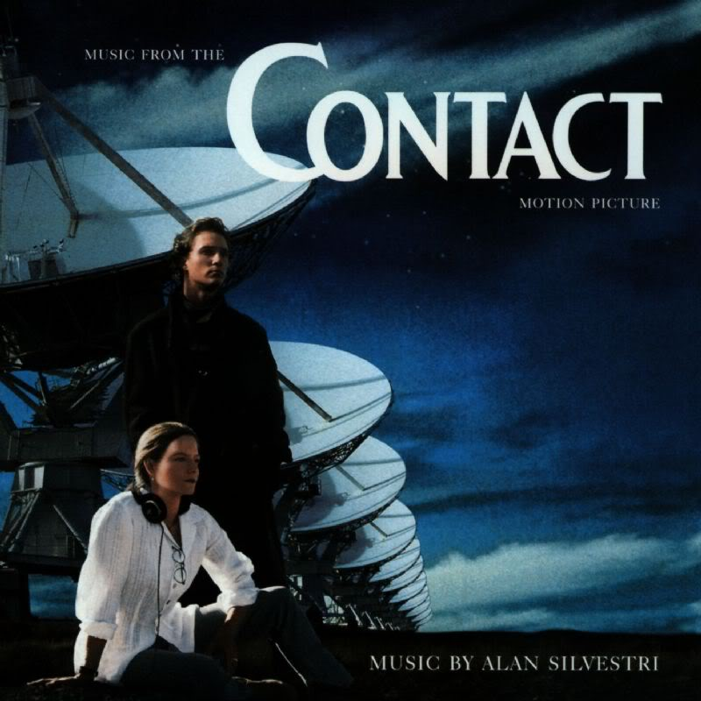
Big Questions:
How did the universe begin? How will it end? What is dark matter?
What is dark energy?
How did the Solar System form?
Are we alone?

Slide 4
Can we use an astronomy theme to convey and illustrate the key concepts of an introductory calculus-level mechanics course?
Key topics:
mathematics: geometry, calculus and vectors
motion: constant acceleration, uniform circular, simple harmonic
Newton’s laws; force
conservation of momentum; center of mass
conservation of energy
conservation of angular momentum; torque

Slide 5
Vectors:
mathematical equivalence of Ptolemaic and Copernican
models
Freedman and Madore (2010)
Hubble’s law → Copernican principle
→ estimate of age of universe

Slide 6
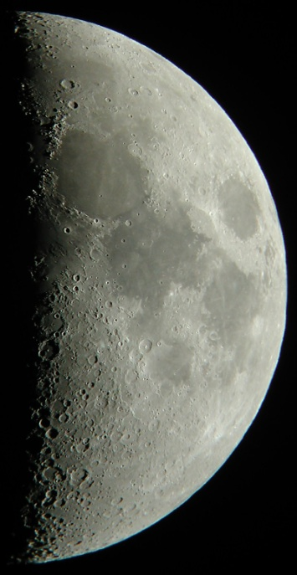
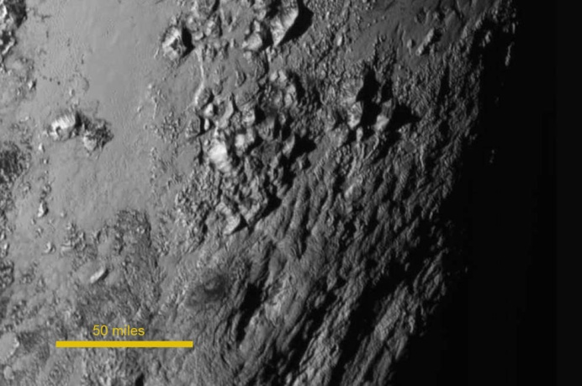
Geometry:
  Hipparchus’ measurement of Earth-Moon distance
  Galileo’s measurement of Moon crater depth
S
E
r_{s}
r_{S}
r_{E}
O
r_{M}
E’
Aristoteles
S’
Eudoxus
R_{ES}
R_{EM}
Moon
or
terminator
Pluto
D. Haworth
NASA/JHUAPL

Slide 7
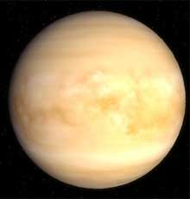
Conservation of Momentum
Cons. Momentum
Center of Mass
Collisions
or
Superball - basketball
Gravity assisted spaceflight

Slide 8
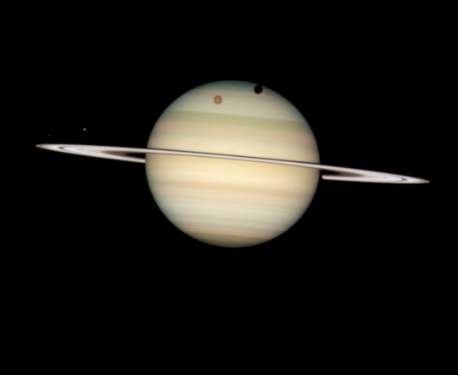
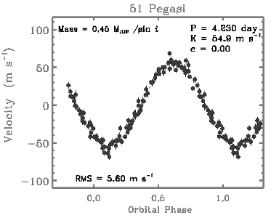
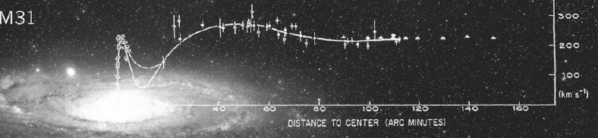
Newton’s laws:
Kepler’s laws → law of Universal Gravitation
→ weigh the Earth, Sun, stars, galaxies
→ why are astronomical bodies spherical?
→ Roche limit: rings vs. moons
→ ocean tides
→ exoplanets
→ dark matter
Mayor and Queloz (1995)
Rubin and Ford (1970)

Slide 9
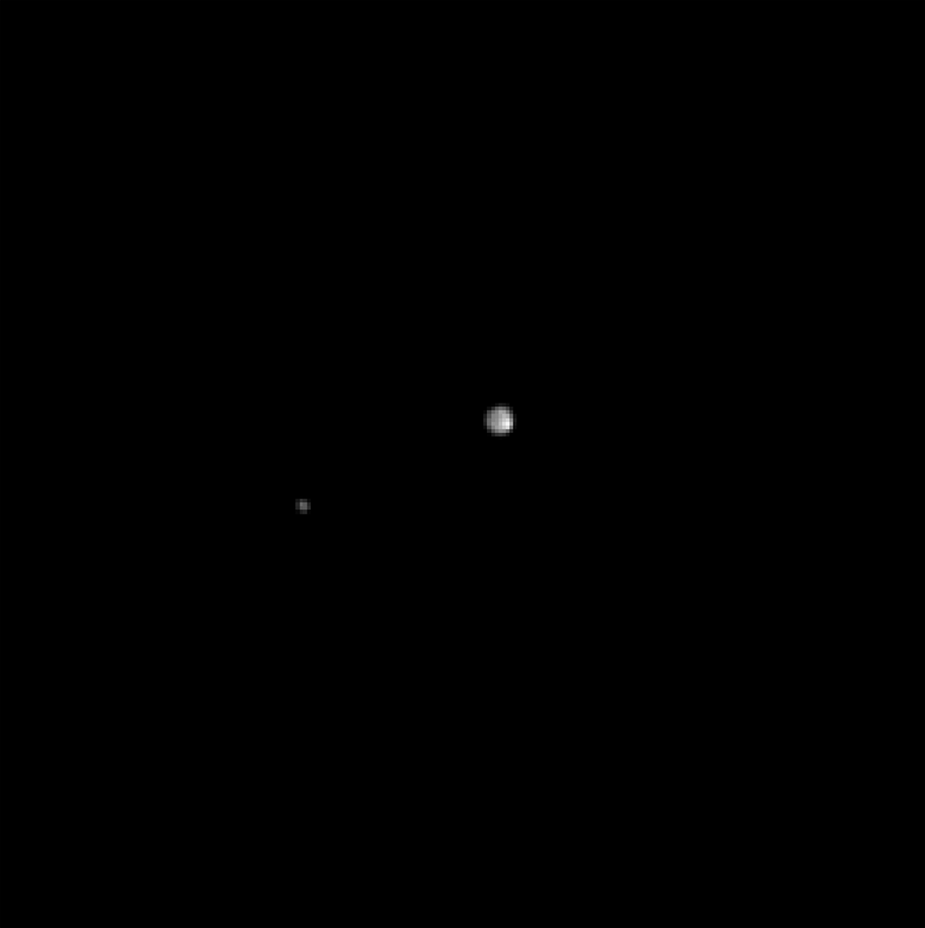
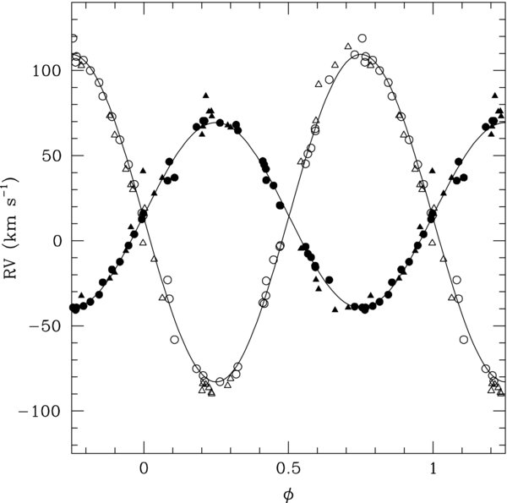
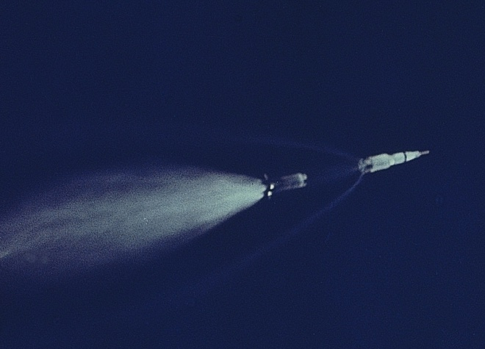

Applications
Binary stars
Rocket propulsion
and
Multi-stage rockets
Cons. Momentum
HD48099
Apollo 11
Center of Mass
Mahy et al (2010)
Pluto & Charon (NASA/JHU)
Exoplanets
Mayor and
Queloz (1995)

Slide 10
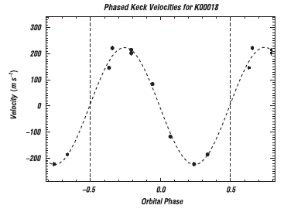
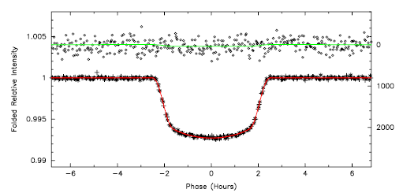
Problem: Exoplanet Kepler 5b: circular orbit about a star M_{star} = 1.37 M_{Sun} orbital speed = 230 m/s, orbital period = 3.55 days.
Find the radius of the planet’s orbit (in AU).
Find the orbital speed of the planet.
Find the planet’s mass (in units of M_{jup}).
When the planet transits the star, the star’s
measured intensity decreases by a factor of
0.007. The transit takes roughly 4.4 hours from
start to finish.
Find the star’s radius (R_{Sun} = 7 x 10⁸ m).
Find the radius of the planet. Compare
this to the R_{Jup} .
Koch et al (2010)

Slide 11
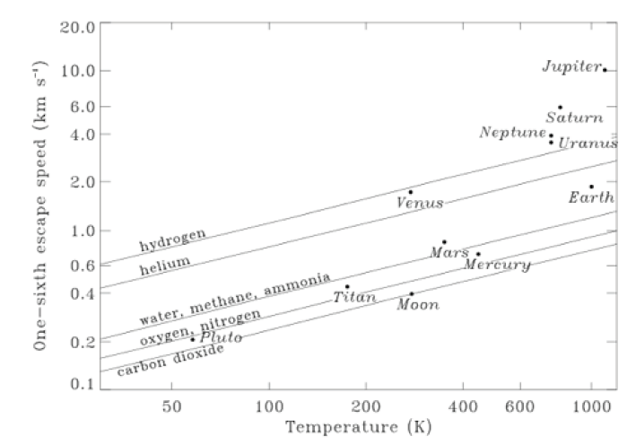
Gravitational potential energy:
escape velocity → planetary atmospheres
orbits (semi-major axis)
interplanetary travel, Hohmann transfer orbit
critical density for closed universe
Catling & Zahnle (2009)
Earth
Mars
r_{p}
r_{a}

Slide 12
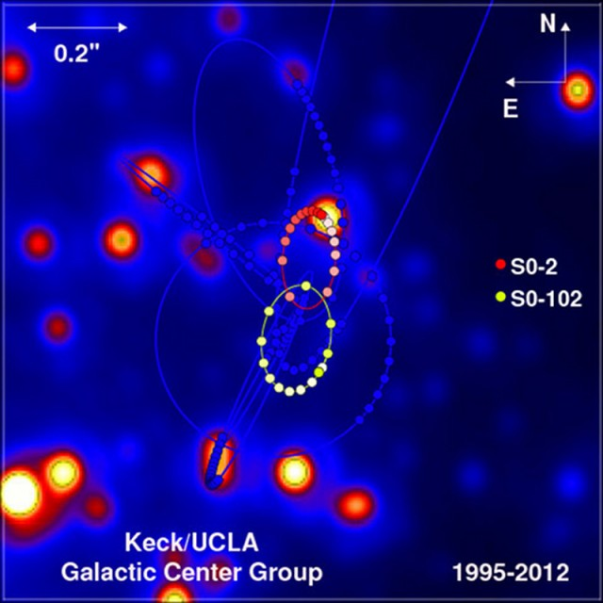
Problem: Sagittarius A is a black hole at the center of MW galaxy. The star labeled S0-2 has been tracked for more than half of its elliptical orbit about the galactic center: T (period) = 15.8 ± .4 yr, ε (eccentricity) = .89 ± .01, a (semi-major axis) = 1040 ± 20 AU.
In 2012, star S0-102 was successfully tracked, with T = 11.5 ± .3 yr and ε = 0.68.
Calculate the mass of Sagittarius A
in terms of solar masses.
(b) Find the semi-major axis of S0-102.
(c) What is the speed of S0-102 at its
periapsis? Express this as a fraction
of the speed of light.

Slide 13
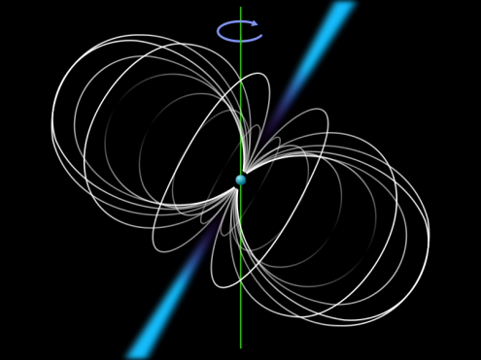

Angular momentum conservation:
pulsars
elliptical orbits (semi-minor axis)
“yo-yo” de-spin of spacecraft
NEO collisions; deflection angle in gravity assist
evolution of Earth-Moon system
θ
R_{E}

Slide 14
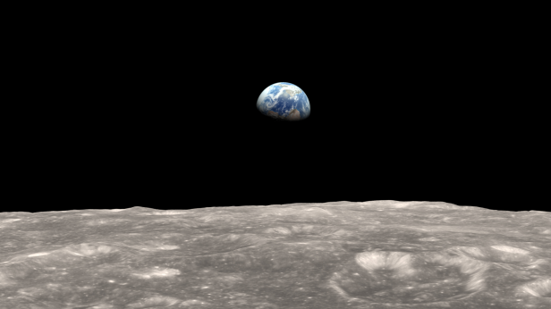
Problem: Tidal effects are slowing Earth’s rotation. Far in the future, the planet’s rotation will be phase-locked to the orbit of the Moon. At that time, the Moon’s orbital angular momentum will be nearly equal to the total angular momentum of the Earth and Moon. ( L_{orb} ≈ 0.8 L_{tot} at the present time.) Use this approximation to answer the following questions.
How far away will the Moon be at that
time? Express your answer in Earth radii.
What will be the length of an Earth day?
What will be the period of the Moon’s
orbit? Express your answers in terms of a
present Earth-day.
Approximately when will this occur?
Ans: (a) 89.3 R_{E} (b) 49.6 d (c) 4.9 Gyr
NASA

Slide 15
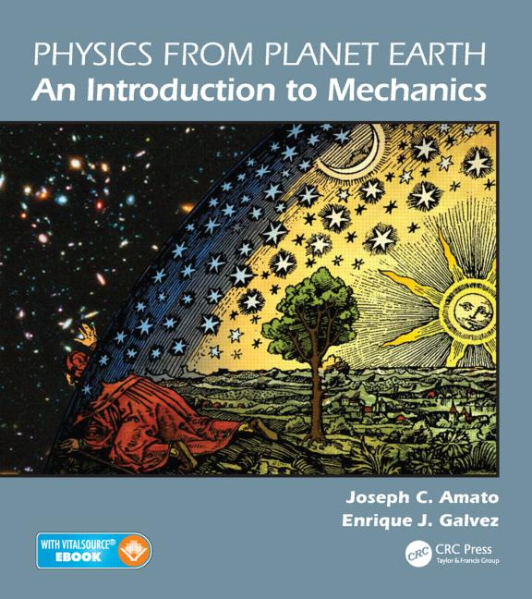
Summary
Astronomy is a very effective way to introduce beginning students to classical mechanics, to motivate the topics of physics, and to inspire students to continue their studies of physics.
Poster: A Textbook for Using Astronomy to Teach Physics, Enrique Galvez, PST2A01, Tuesday 5:00 – 5:45

Slide 17

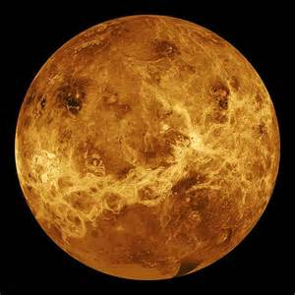
Exercise: One-dimensional “collision”: space probe executing a close fly-by of Jupiter.
What is the probe’s initial velocity relative
to the CM?
(b) What is its final relative velocity ?
What is its final speed relative to the Sun?
Ans: (a) 23 i km/s (b) - 23 i km/s (c) 36 km/s
13 km/s
10 km/s
Problem: 3-dimensional fly-by: Galileo and Venus.
(a) If Venus deflects Galileo by 150° (in the CM
reference frame), what is the final velocity of
the spacecraft relative to the Sun?
(c) Suppose instead that the two bodies are moving
in the same direction, and the spacecraft’s
deflection is 90° (in the CM frame). What is the
final speed of the craft relative to the Sun?
40 km/s
35 km/s

